Slide 1


Mariam Adeboyin AGABA
12th November, 2024

Slide 2

Outline
Executive Summary
Introduction
Methodology
Results
Conclusion
Appendix

Slide 3
Executive Summary
Objective: Analyze SpaceX launch data to evaluate success and identify key performance factors.
Methodologies: Data collection cleaning and processing Exploratory Data Analysis (EDA) using visualization and SQL Interactive dashboards with Folium and Plotly Dash Predictive analysis using logistic regression, SVM, decision trees, and KNN
Results: Identified significant predictors of launch success Achieved over 90% accuracy with the best classification model Insights to enhance future mission planning and safety

Slide 4
Introduction
Overview of SpaceX: Founded in 2002 by Elon Musk, SpaceX aims to revolutionize space travel with reusable rockets, significantly lowering transportation costs and enabling future colonization of Mars.
Data Focus: This project analyzes historical launch data to identify trends and factors affecting launch success, aiding in optimizing future missions and resource allocation.
Objective: To evaluate SpaceX launch success using data analysis, providing insights to enhance mission planning and safety assessment.

Slide 5

Section 1

Slide 6
Methodology
Data Collection: SpaceX launch data sourced from an open dataset. Loaded using pandas for analysis.
Data Wrangling and Processing: Cleaned data by handling missing values, filtering columns, and standardizing formats for analysis.
EDA and SQL Analysis: Used visualizations and SQL queries to explore trends in launch success, rocket types and launch pads.
Interactive Visual Analytics: Created geographic maps with Folium and interactive dashboards using Plotly Dash.
Predictive Analysis: Built classification models (Logistic Regression, SVM, Decision Tree, KNN) to predict launch success.
Model Tuning and Evaluation: Applied GridSearchCV for hyperparameter tuning. Evaluated models with accuracy scores; top model achieved over 90% accuracy

Slide 7
Data Collection
Data Source: SpaceX launch data collected from publicly available datasets.
Collection Process: Step 1: Identified and downloaded dataset from API and CSV files. Step 2: Imported into Python using pandas library for processing. Step 3: Filtered relevant columns: Rocket, Payloads, Launchpads, Cores
Data Identification
Download
Import to Python
Filter for Relevance

Slide 8
Data Collection – SpaceX API
Data Source: SpaceX Launch Data via SpaceX REST API
Collection Process: Step 1: Made API calls to retrieve launch data.
Step 2: Parsed JSON response into pandas DataFrame.
Step 3: Extracted key fields such as Rocket, Payloads, Launchpads, and Cores.
https://github.com/Hajaratitilope/testrepo/blob/main/jupyter-labs-spacex-data-collection-api.ipynb
API Request
Parse JSON Response
Dataframe Creation
Data Extraction

Slide 9
Data Collection - Scraping
Data Source: Scraped historical SpaceX data from SpaceX website using BeautifulSoup and requests libraries.
Scraping Process:
Step 1: Sent HTTP requests to target web pages.
Step 2: Parsed HTML content with BeautifulSoup.
Step 3: Extracted relevant data such as mission names, launch dates, and rocket details into a pandas DataFrame.
https://github.com/Hajaratitilope/IBM-Capstone-Project/blob/main/jupyter-labs-webscraping.ipynb
HTTP Request
Data Extraction
Store in Dataframe
Parse HTML

Slide 10
Data Wrangling
Data Processing Overview:
Step 1: Identified and handled missing values using pandas.
Step 2: Performed data type conversions for numerical and datetime fields.
Step 3: Cleaned, filtered, and merged datasets (API & scraped data) to create a unified dataset for analysis.
https://github.com/Hajaratitilope/IBM-Capstone-Project/blob/main/labs-jupyter-spacex-Data%20wrangling.ipynb
Identify Missing Data
Data Type Conversion
Merge Datasets
Clean and Filter

Slide 11
EDA with Data Visualization
Charts Plotted: Bar Charts: To visualize rocket launch success rates across years.
Pie Charts: To show the distribution of launch outcomes (success vs failure).
Scatter Plots: To analyze the relationship between payload mass and launch success.
Line Plots: To track trends in launch frequency over time.
Purpose of Charts: Bar & Pie Charts: Highlighted categorical data for success analysis.
Scatter & Line Plots: Examined trends and relationships over time.
https://github.com/Hajaratitilope/IBM-Capstone-Project/blob/main/edadataviz%20(1).ipynb

Slide 12
EDA with SQL
SQL Queries Performed:
SELECT: Extracted data on successful rocket launches.
GROUP BY: Analyzed launch outcomes by year and launchpad.
JOIN: Combined datasets for rocket performance and payload analysis.
ORDER BY: Ranked launches by success rate and payload mass.
https://github.com/Hajaratitilope/IBM-Capstone-Project/blob/main/jupyter-labs-eda-sql-coursera_sqllite.ipynb

Slide 13
Build an Interactive Map with Folium
Map Objects Created: Markers: Indicated launch sites for better visibility of locations.
Circles: Represented launch zones to visualize operational areas.
Polylines: Illustrated rocket trajectories to demonstrate flight paths.
Rationale for Objects: Markers provide quick identification of launch sites.
Circles help visualize operational impact zones.
Polylines enhance understanding of launch trajectories.
https://github.com/Hajaratitilope/IBM-Capstone-Project/blob/main/lab_jupyter_launch_site_location_folium.ipynb

Slide 14
Build a Dashboard with Plotly Dash
Dashboard Components: Pie Chart: Displays the percentage of launches per site.
Scatter Plot: Visualizes the relationship between payload and launch outcome.
Rationale for Components: Pie Chart provides quick insights into launch site distributions.
Scatter Plot helps analyze the correlation between payload sizes and launch success rate
https://github.com/Hajaratitilope/IBM-Capstone-Project/blob/main/dashboard.py

Slide 15
Predictive Analysis (Classification)
Model Development Process:
Model Selection: Chose classifiers (Logistic Regression, SVM, Decision Tree, KNN).
Hyperparameter Tuning: Used GridSearchCV for optimal parameters.
Model Evaluation: Employed accuracy, precision, recall, and F1-score metrics.
Best Performing Model: Identified Decision Tree with the highest accuracy after tuning.
https://github.com/Hajaratitilope/IBM-Capstone-Project/blob/main/SpaceX_Machine%20Learning%20Prediction_Part_5.ipynb
Model Selection
Hyperparameter Tuning
Model Evaluation
Best Performing Model

Slide 16
Results
Exploratory data analysis results
Interactive analytics demo in screenshots
Predictive analysis results

Slide 17

Section 2

Slide 18
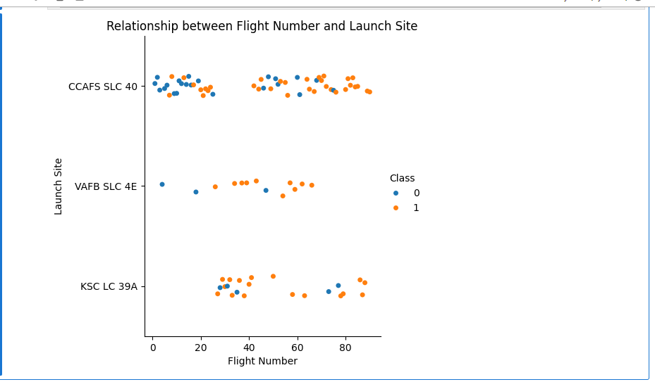
Flight Number vs. Launch Site

Slide 19
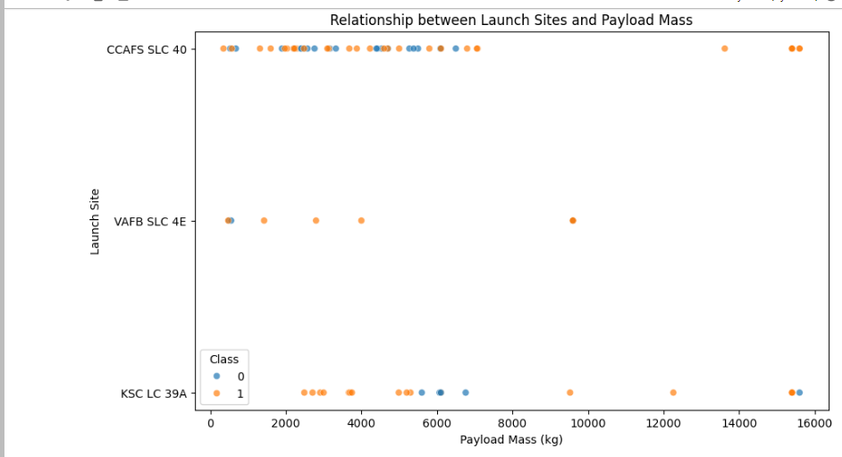
Payload vs. Launch Site

Slide 20
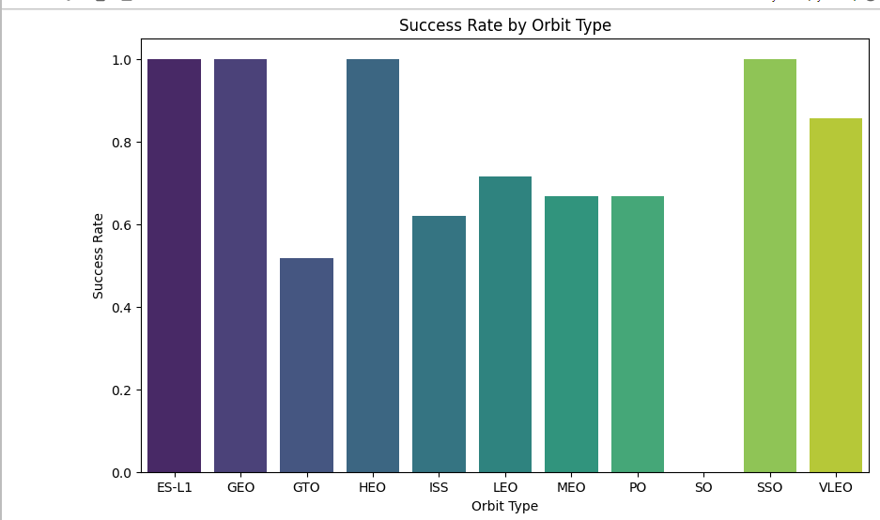
Success Rate vs. Orbit Type

Slide 21
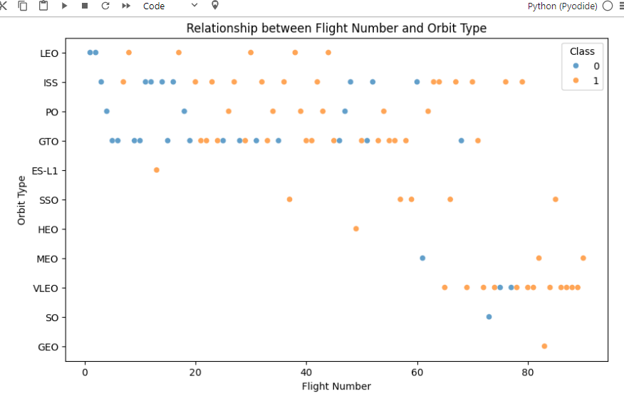
Flight Number vs. Orbit Type

Slide 22
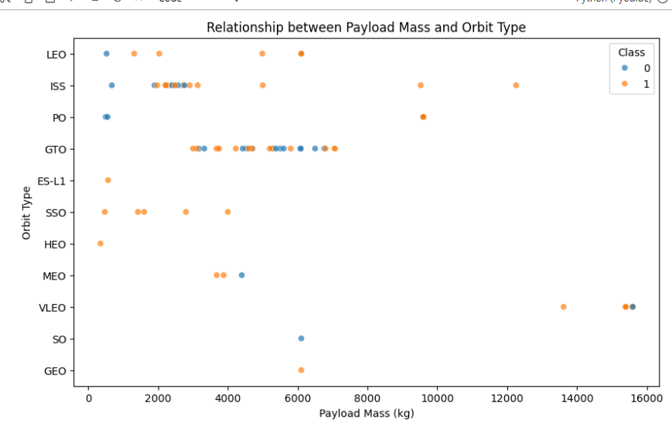
Payload vs. Orbit Type

Slide 23
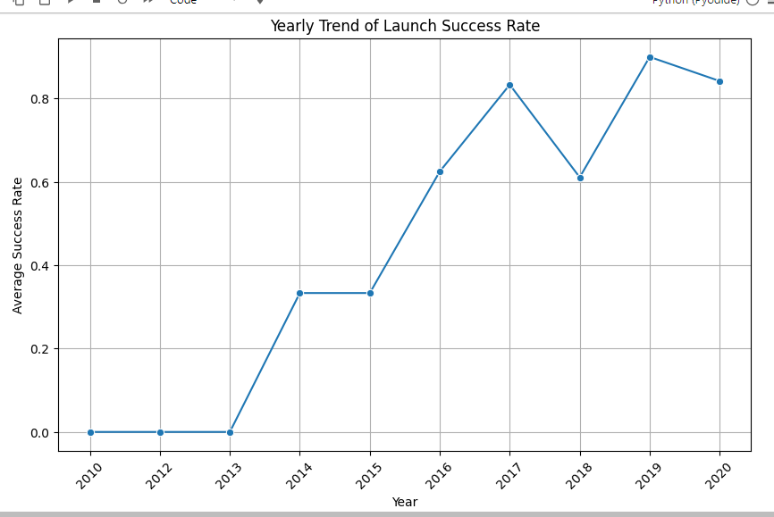
Launch Success Yearly Trend

Slide 24
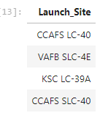
All Launch Site Names

Slide 25
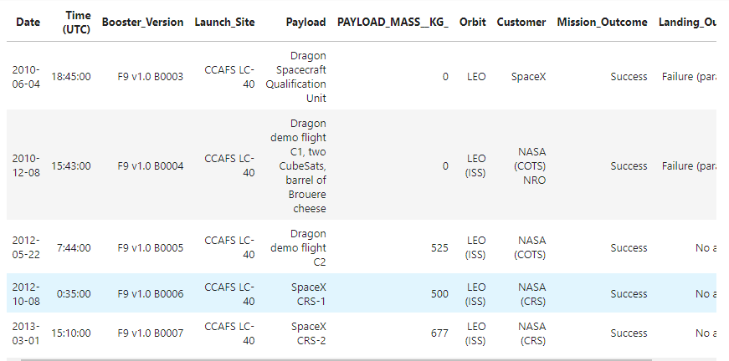
Launch Site Names Begin with 'CCA'

Slide 26
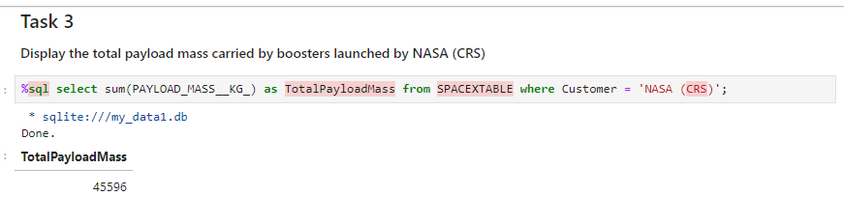
Total Payload Mass

Slide 27
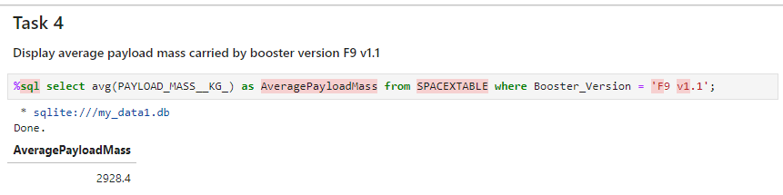
Average Payload Mass by F9 v1.1

Slide 28
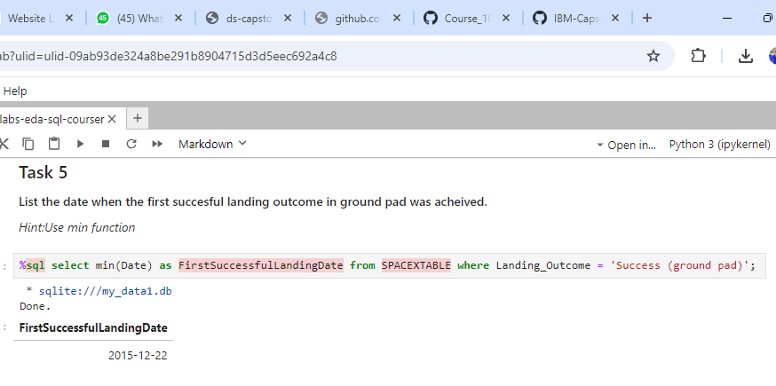
First Successful Ground Landing Date

Slide 29
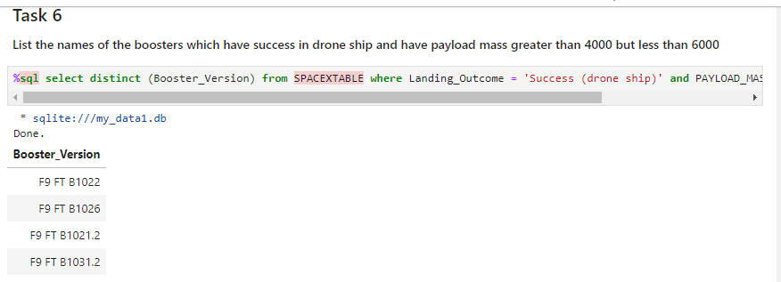
Successful Drone Ship Landing with Payload between 4000 and 6000

Slide 30
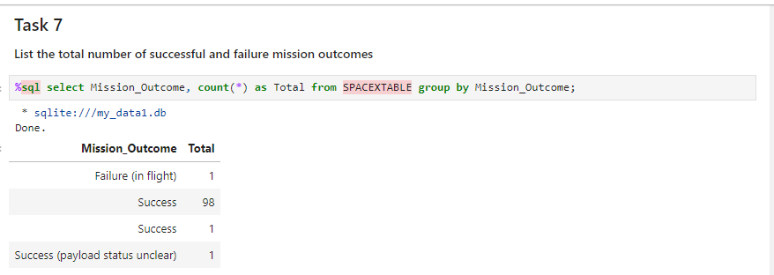
Total Number of Successful and Failure Mission Outcomes

Slide 31
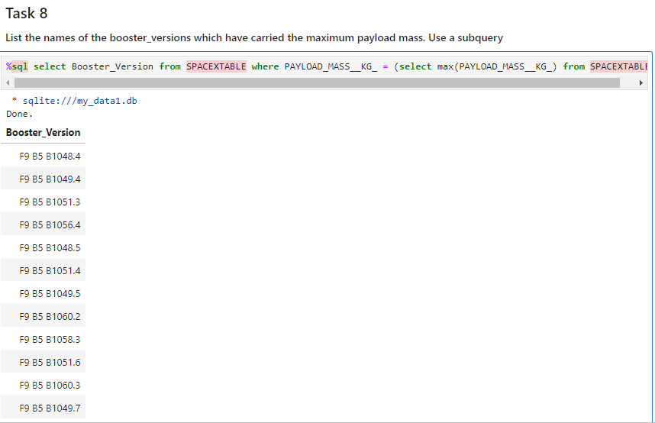
Boosters Carried Maximum Payload

Slide 32
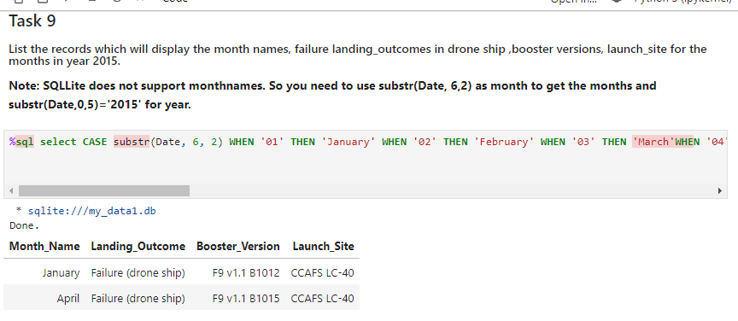
2015 Launch Records

Slide 33
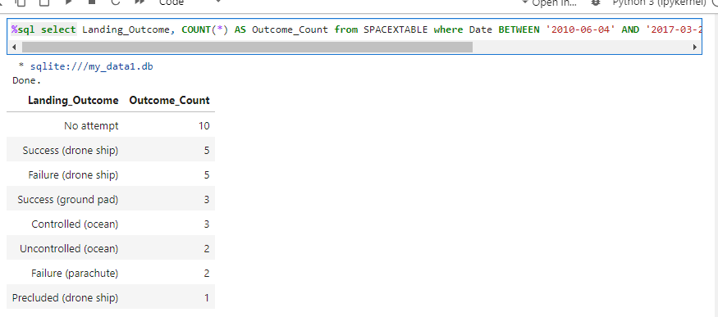
Rank Landing Outcomes Between 2010-06-04 and 2017-03-20

Slide 34

Section 3

Slide 35
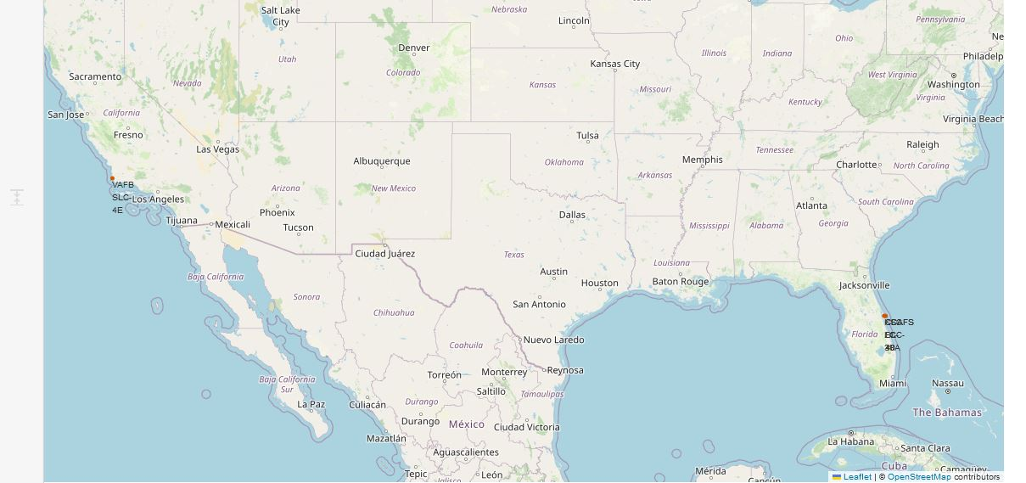
SpaceX Launch Sites' Location Markers on Global Map

Slide 36
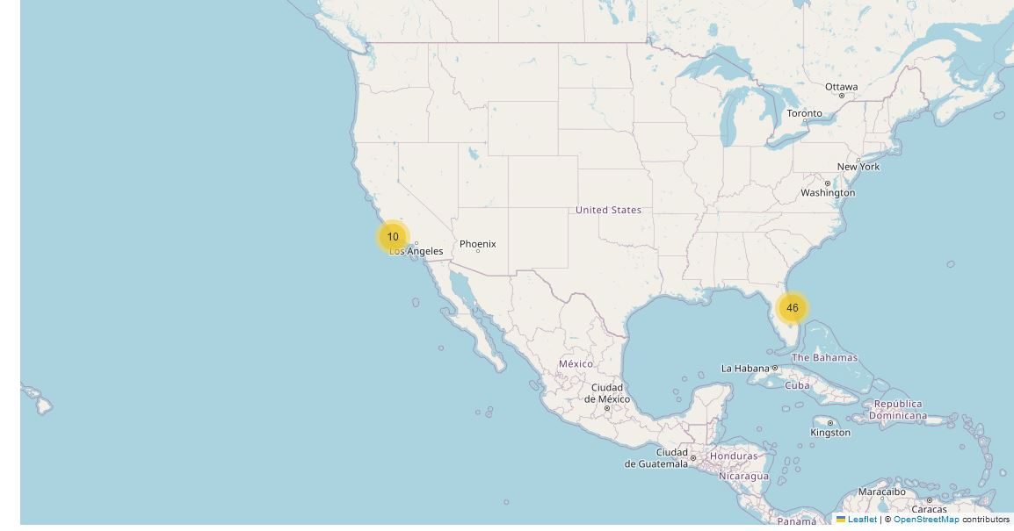
Launch Outcomes Depiction on Global Map

Slide 37
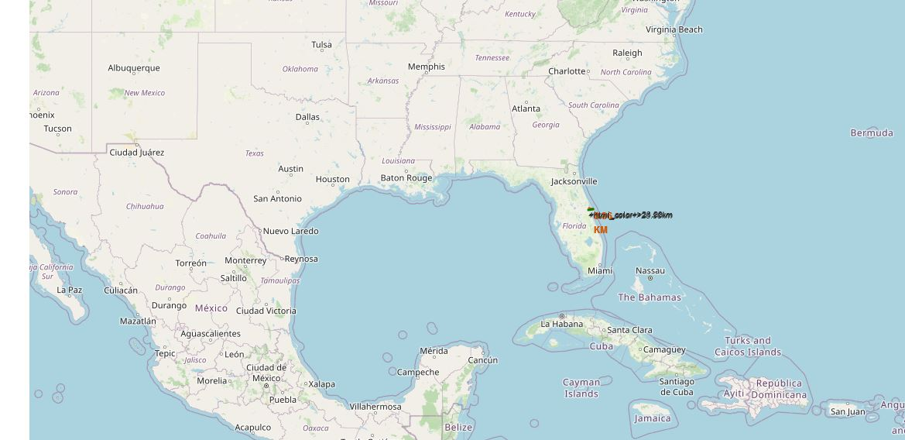
Proximity Analysis of Selected Launch Site on Global Map

Slide 38

Section 4

Slide 39
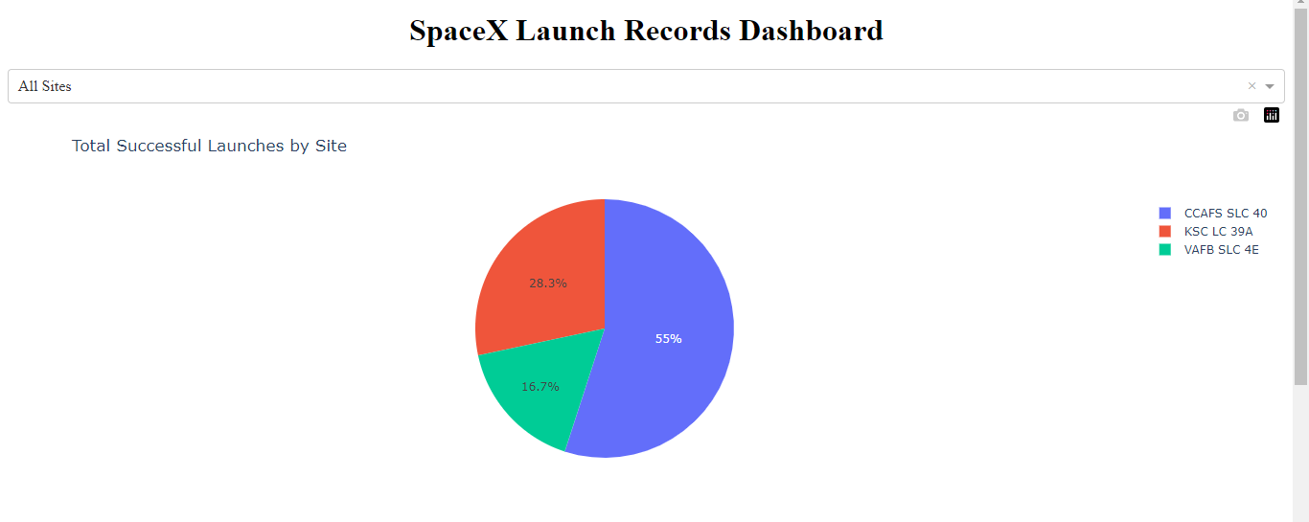
Total Successful Launches by Site

Slide 40
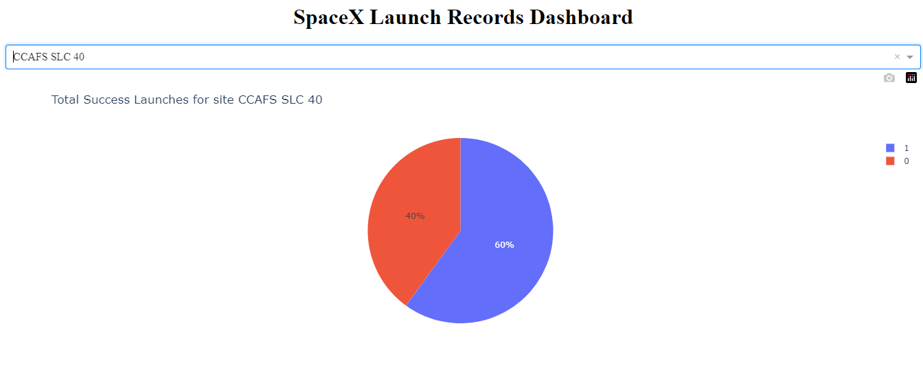
Total Success Launches for Site CCAFS SLC 40

Slide 41
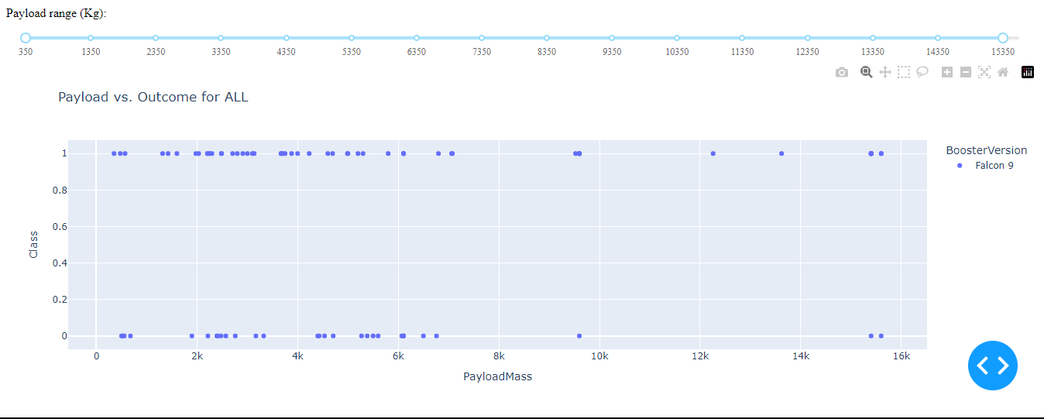
PayloadMass VS Outome for All Sites

Slide 42

Section 5

Slide 43
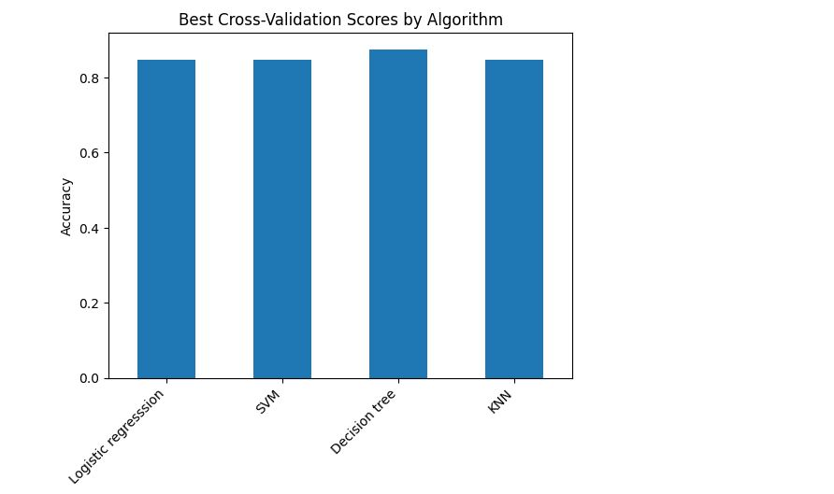
Classification Accuracy

Slide 44
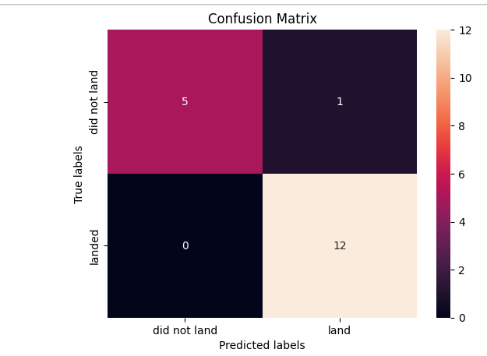
Confusion Matrix of Decision Tree Classifier Model

Slide 45
Conclusions
SpaceX primarily uses a few key launch sites, which are optimized for frequent and successful launches.
Analysis shows a significant increase in the number of launches over time, indicating SpaceX's operational scalability and growth.
Factors such as flight number, payload, and core configurations influence the success of launches and overall mission reliability.
The Decision Tree Classifier proved to be the best-performing model in the predictive analysis, delivering the highest accuracy in forecasting future launch outcomes.
Visual analytics and SQL queries provided actionable insights for SpaceX's operational strategies, further aiding future mission planning and success rates.

Slide 46
Appendix
Include any relevant assets like Python code snippets, SQL queries, charts, Notebook outputs, or data sets that you may have created during this project

Slide 47


